Slide 1
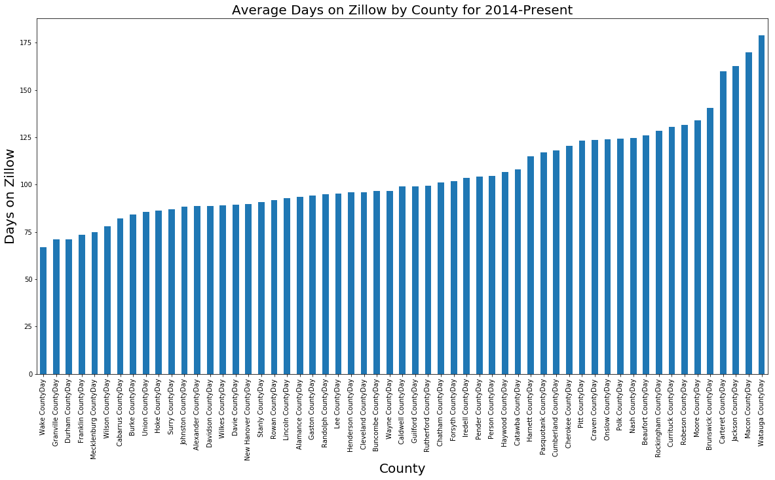

Slide 2
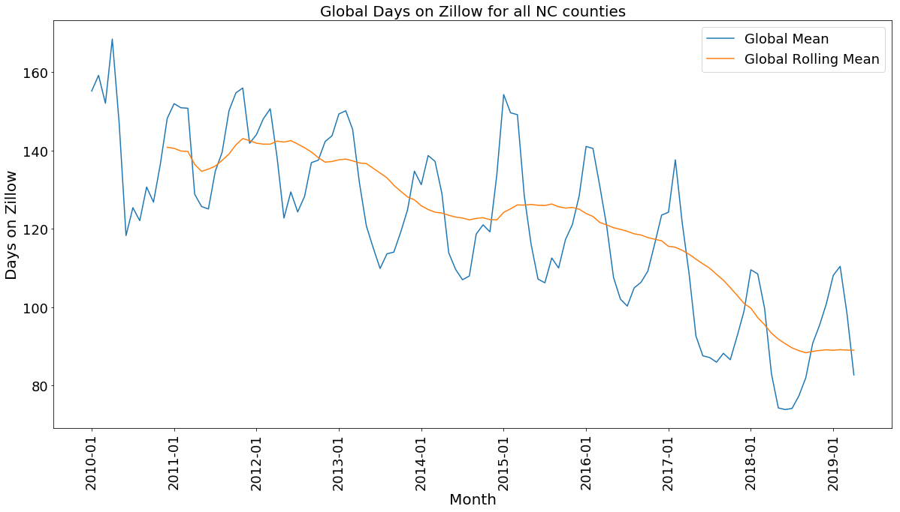

Slide 3
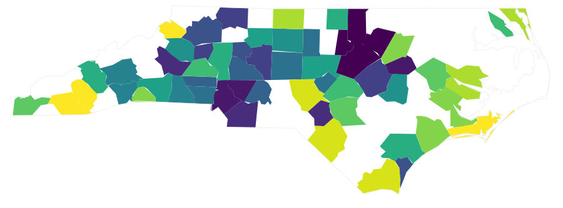
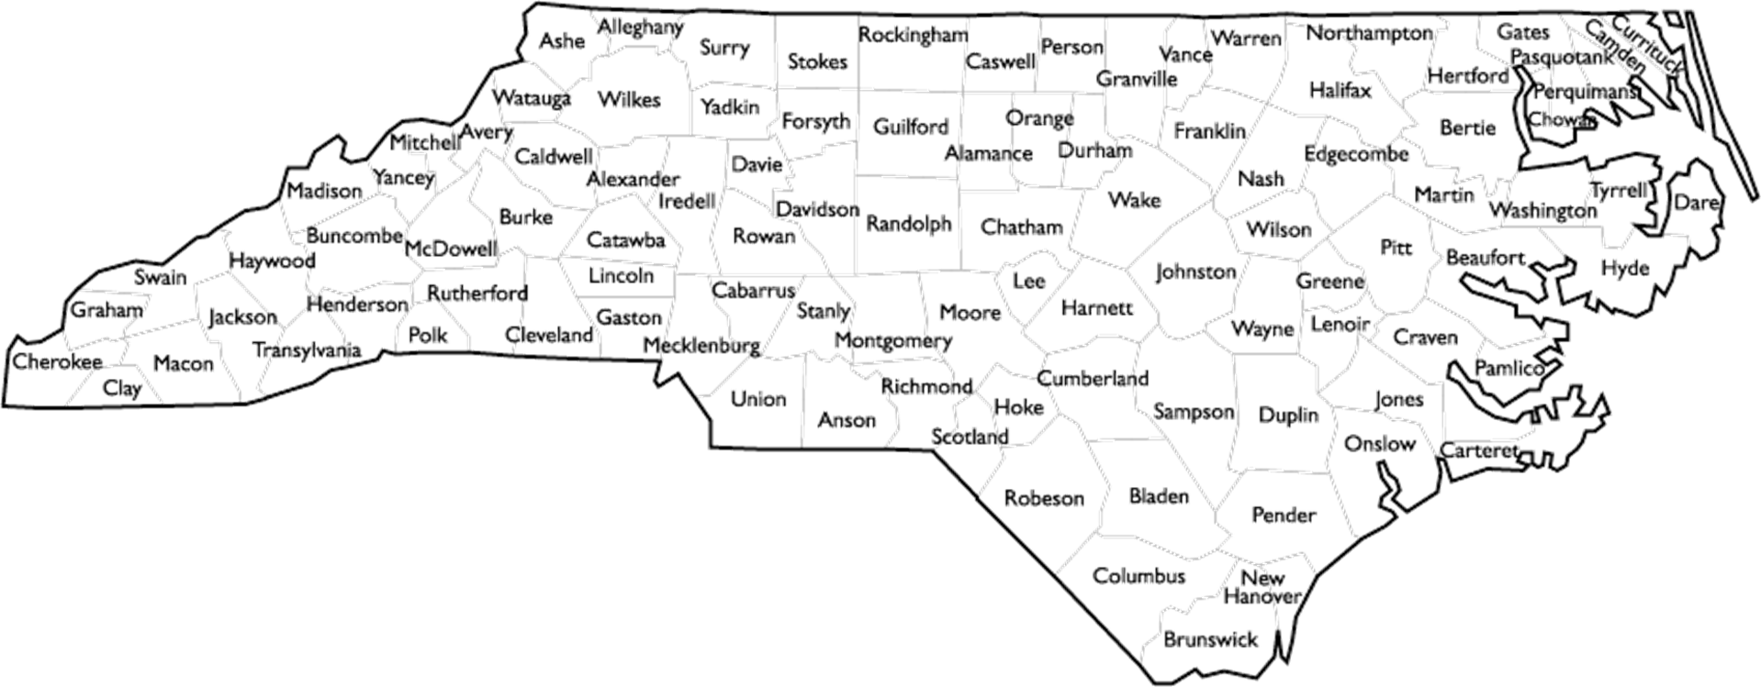
Average Days on Zillow for NC Counties (2014-Present)
Lowest Number of Days
Highest Number of Days

Slide 4
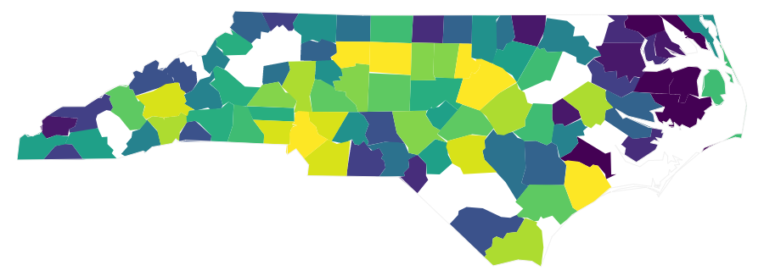
Average Sales on Zillow for NC Counties (2014-Present)
Lowest Sales
Highest Sales

Slide 5
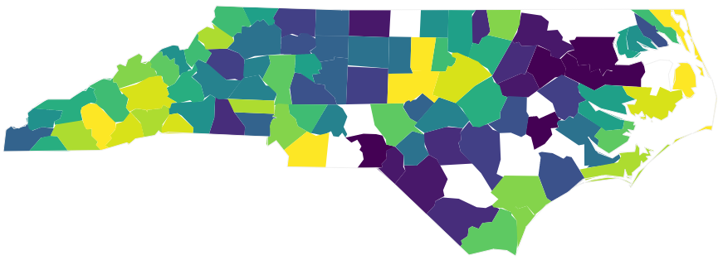
Average Price on Zillow for NC Counties (2014-Present)
Lowest Price
Highest Price

